Slide 1

Amazon Clone
Akansha Saxena
Ananya Jain
Kanishk Bharadwaj

Slide 2
About the project
It is a Clone of an E-Commerce website ,which almost all of us use in our daily life
We have tried to replicated features of Amazon Shopping website.
WE have tried to replicate the Frontend also, to the best of our ability.
Some of the features that we have tried to replicate are : User Authentication, using Firebase , Cart with real time check-ins of items.

Slide 3

Objective
To give the exact feel of E-commerce website of Tech-Giant AMAZON.

Slide 4

.
INTRODUCTION
It is an amazon clone which gives a dummy idea of that website.
It has various features like User authentication.
We have also implemented the cart real time access

Slide 5
Problem Statement
Replication of E-commerce website
Various Business don’t get the exposure just because they don’t have a website for their customers. So here by building this we have learnt the required skills which can be implemented there.

Slide 6

TECHNOLOGIES USED

Slide 7

Contd..
REACT
HTML
CSS
BOOTSTRAP
Firebase

Slide 8

REACT
It is an open-sourced, front-end JavaScript library for building user interfaces or UI components.
React makes it painless to create interactive UIs. Design simple views for each state in your application, and React will efficiently update and render just the right components when your data changes.

Slide 9

HTML
HTML stands for Hyper Text Mark-up Language, which is the most widely used language on the Web to develop web pages.
Now we are using HTML5.0

Slide 10

CSS
CSS handles the look and feel part of a web page.
Using CSS, you can control the colour of the text, the style of fonts, the spacing between paragraphs, how columns are sized and laid out, what background images or colors are used, layout designs, variations in display for different devices and screen sizes as well as a variety of other effects.

Slide 11

Firebase
Firebase helps you build and run successful apps. Backed by Google.
Its various features are:
Real time database
User authentication
Hosting

Slide 12

FUTURE SCOPE
Payment gateway integration
Addition of some actual products for a fully fledged business.
Converting this into a secured and optimized website for large traffic.

Slide 13

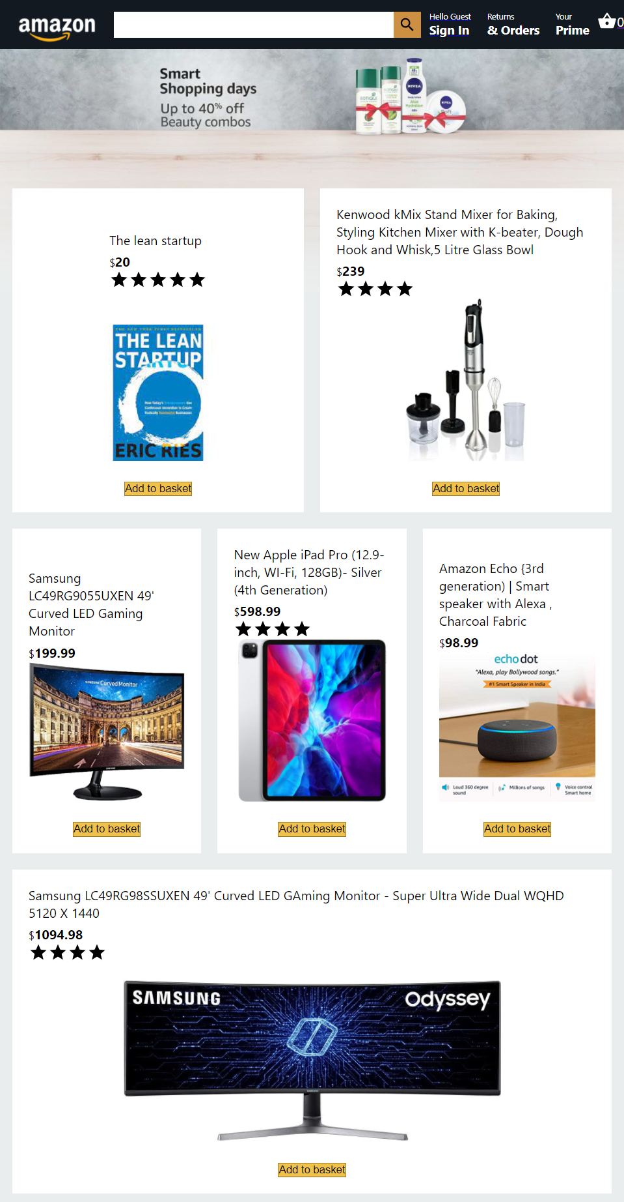
Mobile View

Slide 14
Tablet View
.

Slide 15
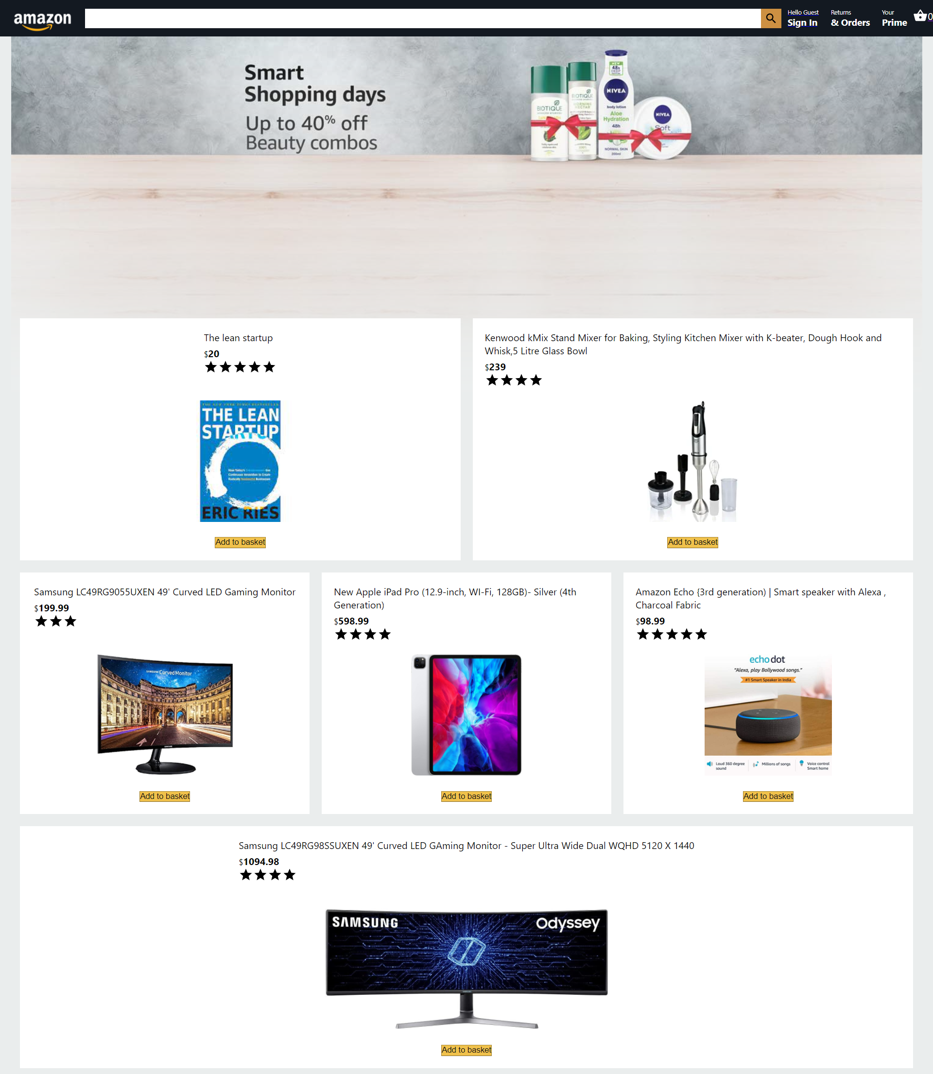
Desktop View

Slide 16
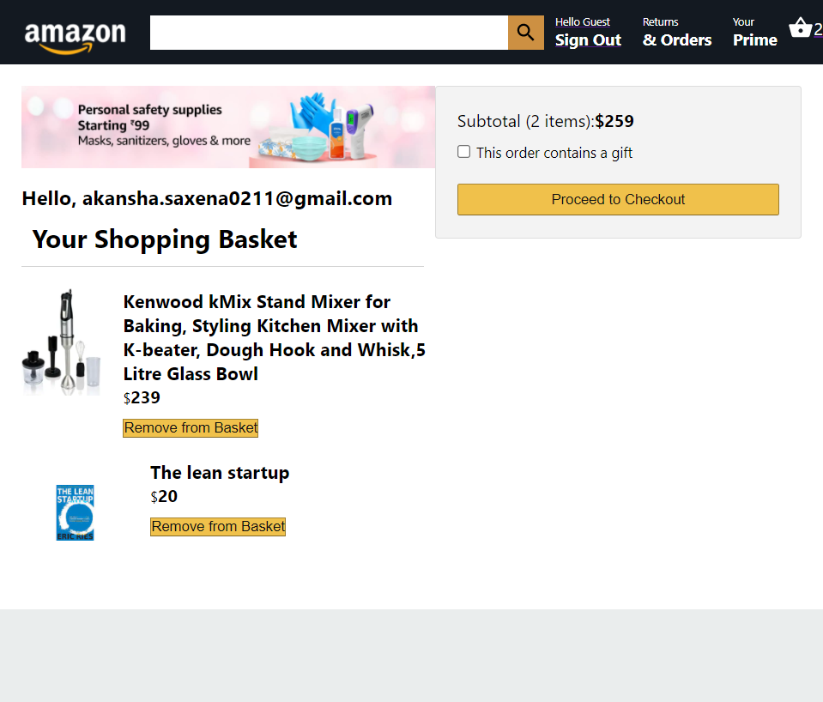
SHOPPING BASKET COMPONENT

Slide 17
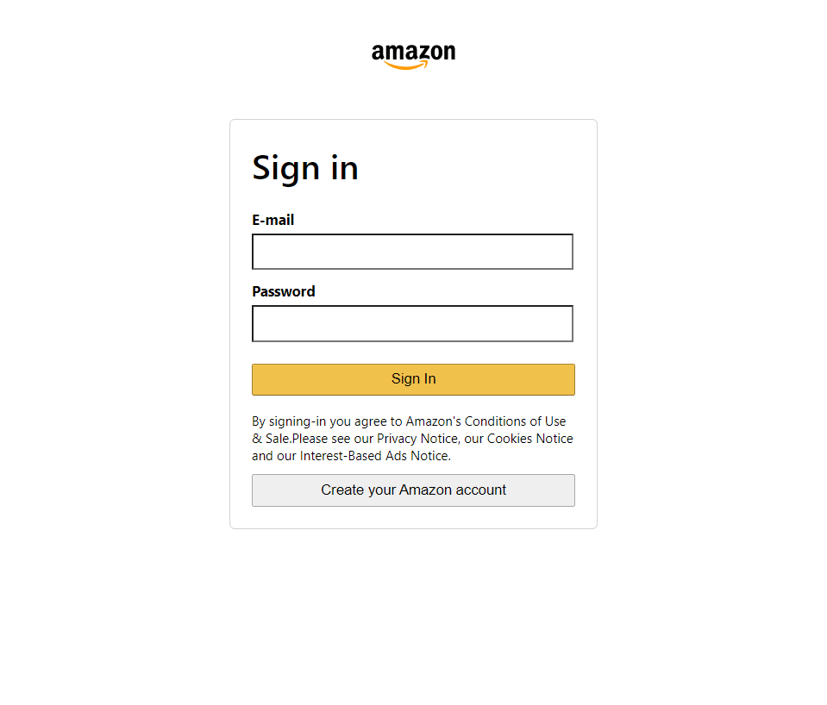
SIGN-IN COMPONENT

Slide 18

thanks!
ANY
QUESTIONS?

